Slide 1
السلام عليكم

Slide 2
Our Project Or Task

Slide 3
Main points
Selection sort
Linked lists
How to sort linked list using selection sort
Example
Practical Example

Slide 4
Selection Sort
You Remember It ?!

Slide 6
Linked Lists
You Remember It ?!

Slide 7
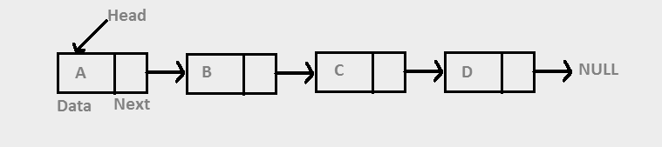

Slide 8
Steps To solve the problem
Creating linked list class
Creating node class

Slide 9
Steps To solve the problem
Find the smallest element in the linked list
Swapping it

Slide 10
Swapping

Slide 11
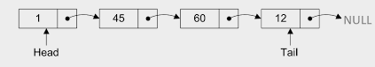
Let us have an example

Slide 12
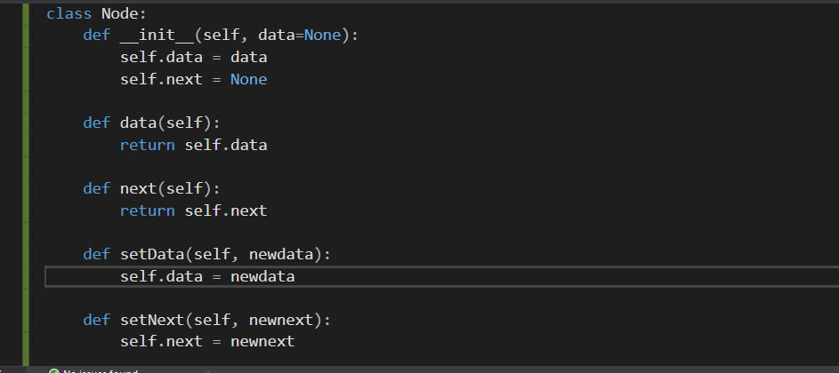
code

Slide 13
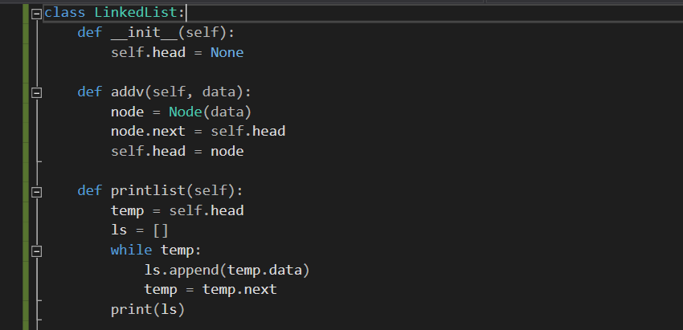

Slide 14
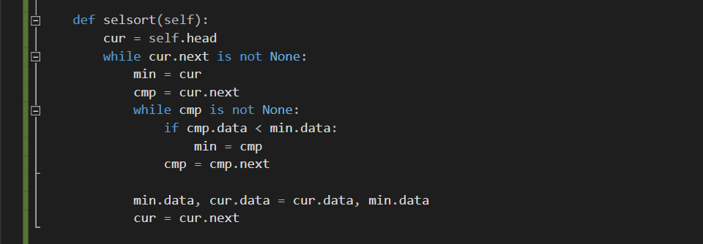

Slide 15
Practical Example

Slide 16
Suggestions for edits

Slide 17
Team
Mohammed Hassan
Mohammed Moussa
Mostafa Ebrahim
Mostafa Elshiekh
Mohamed Elzorkany
Moimen Ezzeldeen
Youssef Belal
Mohammed Mourad
Moaz Waleed
Mostafa Mosaad

Slide 18
Thank You

